Slide 1

Malignant Comments Classifier

Slide 2
SUBMITTED BY Steffin Varghese

Slide 3
INTRODUCTION
Social media has spawned numerous job prospects in the twenty-first century while also developing into a distinctive forum for individuals to openly express their thoughts. There are some groups among these users, however, that abuse this framework and this freedom to spread their negative viewpoints (i.e., insulting, verbal sexual harassment, threads, Obscene, etc.).
Derogatory remarks are frequently uttered by people nowadays, not just in offline settings but also significantly in online settings like social networking sites and online communities. Therefore, it is essential that all social networking platforms and applications, as well as all online communities, include an Identification with Prevention System.

Slide 4
Online hate, described as abusive language, aggression, cyberbullying, hatefulness, and many others has been identified as a major threat on online social media platforms. Social media platforms are the most prominent grounds for such toxic behaviour.
There has been a remarkable increase in the cases of cyberbullying and trolls on various social media platforms. Many celebrities and influences are facing backlashes from people and have to come across hateful and offensive comments. This can take a toll on anyone and affect them mentally leading to depression, mental illness, self-hatred, and suicidal thoughts.
The proliferation of social media enables people to express their opinions widely online. However, at the same time, this has resulted in the emergence of conflict and hate, making online environments uninviting for users. Internet comments are bastions of hatred and vitriol.
Although researchers have found that hate is a problem across multiple platforms, there is a lack of models for online hate detection. While online anonymity has provided a new outlet for aggression and hate speech, machine learning can be used to fight it. The problem we sought to solve was the tagging of internet comments that are aggressive towards other users. This means that insults to third parties such as celebrities will be tagged as unoffensive, but “u are an idiot” is clearly offensive. In such a system, the Identification Block would be responsible for seeing any unfavourable online behaviour and alerting the Prevention Block to take appropriate action.

Slide 5
Steps in Exploratory Data Analysis
Loading the dataset
Text Processing
Characteristics of Dataset
Checking for Missing Values
Balancing Data
Data Visualization
Text Vectorization

Slide 6
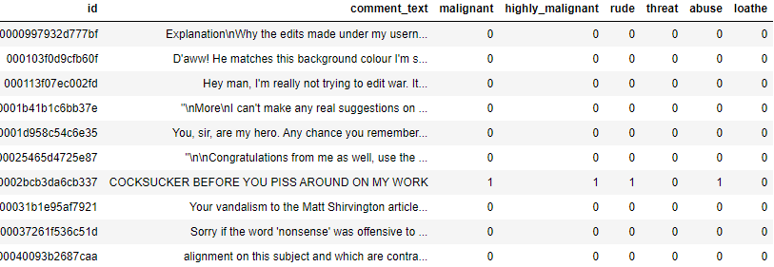
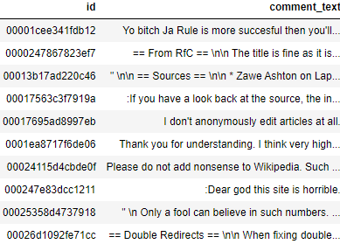
Data Sources and their formats
Train Dataset
We have 159,571 records and 8 columns including the target variable in the train dataset. In the test dataset, we have 153,164 records and two features.
We have string and integer type of data in the train dataset. We only have string type of data in the test dataset.
We have 159,571 non-null values in all the columns of train dataset and 153,164 non-null values in all the columns of test dataset.
Test Dataset

Slide 7
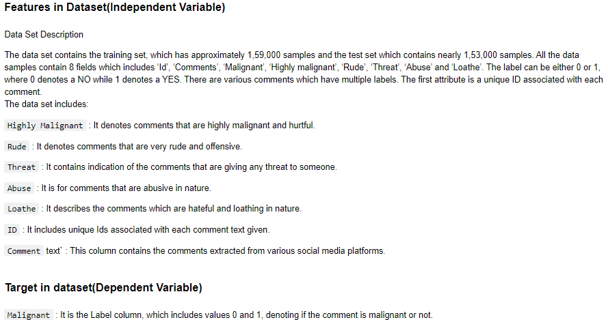
Data Variable Description

Slide 8
Data Preprocessing
Text Processing
While exploring the categorical variables, there are many words, numbers, as well as punctuations which are not important for our predictions. So, we had to process the text.
We have dropped the column ‘id’ from the train and test dataset as it was provided only for the identification of each comment.
We used a user defined function to clean the text and we removed numbers, URLs, punctuations, and other unwanted characters from the train and test data and unshrink the words which were mentioned in short forms.
Removed stop words from train and test dataset.
Lemmatization – Using wordnet lemmatizer and word tokenize, we removed the inflected forms of words and converted them to their ‘lemma’ or dictionary form.

Slide 9
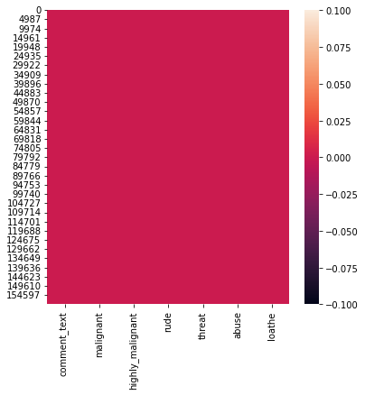
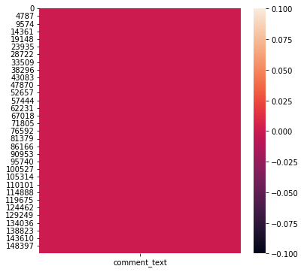
Checking for Missing Values
Heatmap of null values in train dataset.
Heatmap of null values in test dataset
There are no missing values in the test and train dataset.

Slide 10
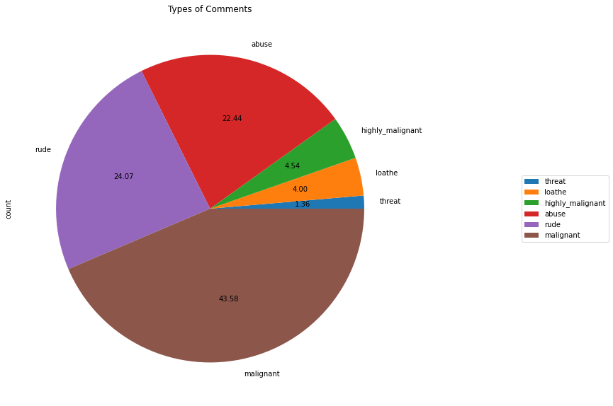
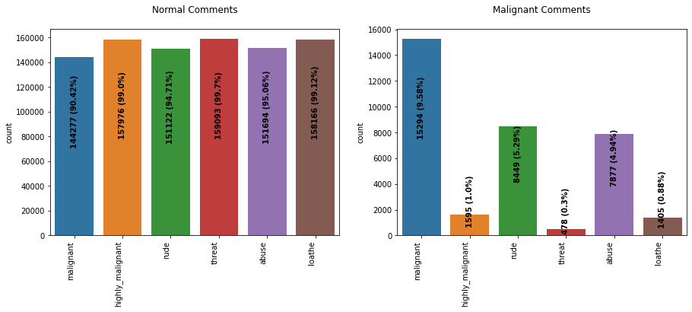
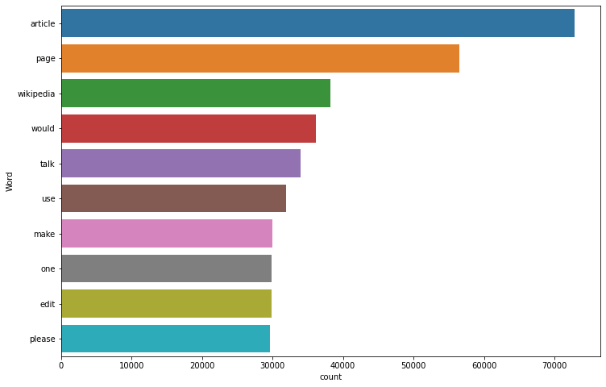
Data Visualization
Segmentation of comments based on the nature.
Countplot of comments based on nature
Most frequent words used in comments

Slide 11
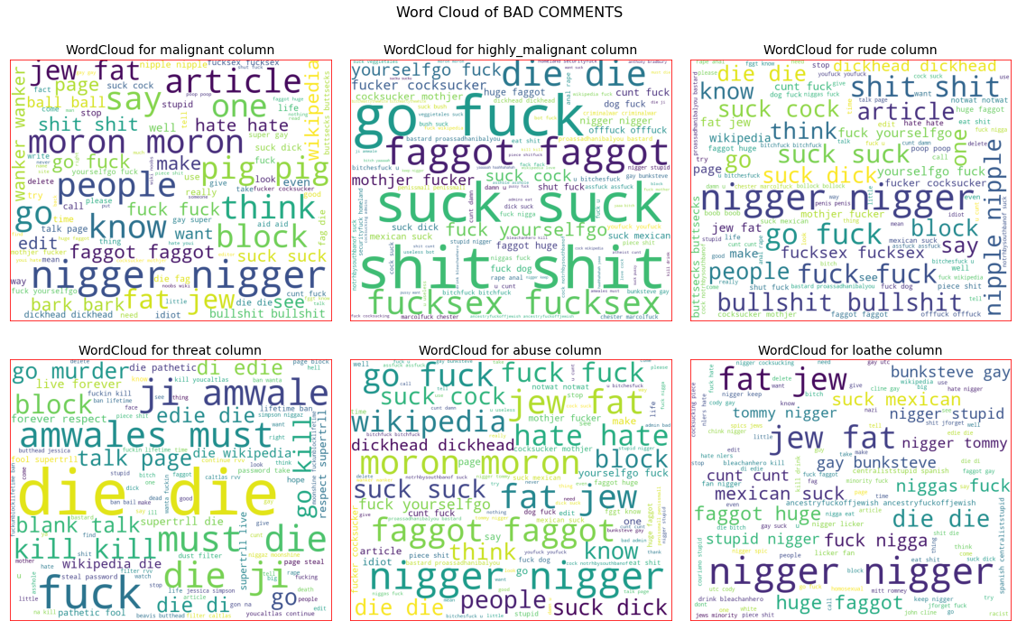
Observations:
Malignant comments are comparatively higher than other features in the dataset. Rude and abusive comments are also more visible in the comments.
Comments which are having threatening are comparatively low in the train dataset.
As per the data, normal comments which are not malignant are having almost normal distribution for each type of features in the dataset.
['article', 'page', 'Wikipedia'] are the words which are most frequent in the comments.
The word cloud of the bad comments shows the loud words which have used by the users. The presence of these words are making the comments malignant.
Word Cloud for loud words in bad comments

Slide 12
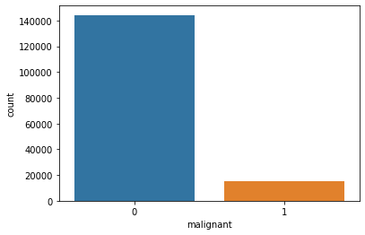

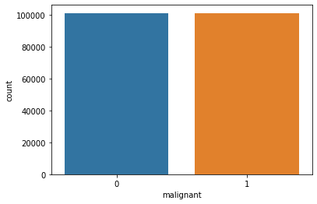
Model/s Development and Evaluation
Identification of possible problem-solving approaches (methods)
Vectorizing the Text Data in Dataset
We used tfidf vectorizer for vectorizing the text data in the dataset.
Balancing the dataset
We used smote technique to oversample the data in dataset to equalize the number of records in each categories.
Unbalanced dataset
Balanced Dataset

Slide 13
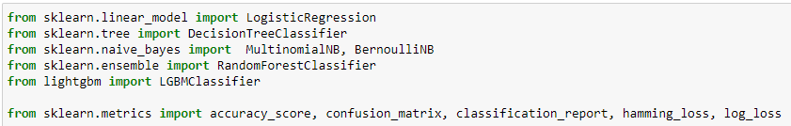
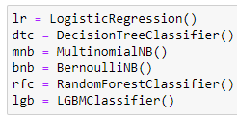
Building the Model
Algorithms and metrics for evaluation
We have created two user defined functions to train, test and cross validate the models with the pre-processed train data.
mod_test: Training and testing the model
cross_val: Finding the best cross validation mean score for each model.
Instances of Algorithms

Slide 14
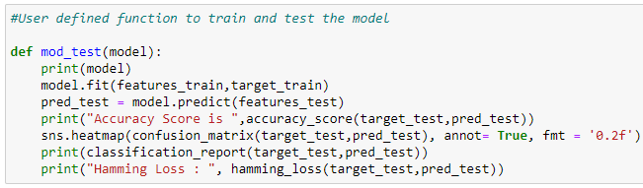
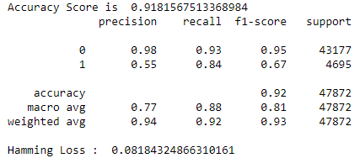
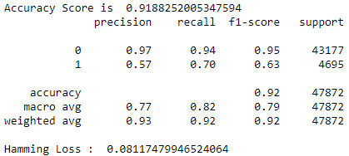
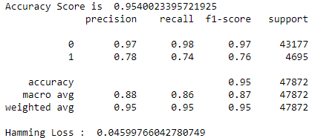
Testing of Identified Approaches (Algorithms) and evaluation of selected models
User Defined Function for Training and Testing the model
Logistic Regression
DecisionTreeClassifier
Multinomial NB
Testing the model performance
Testing the model performance
Testing the model performance

Slide 15
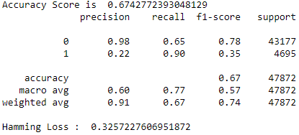
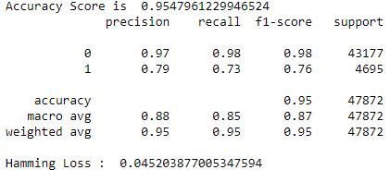
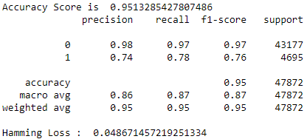
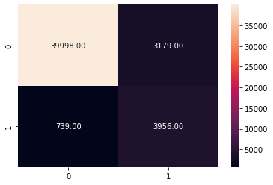
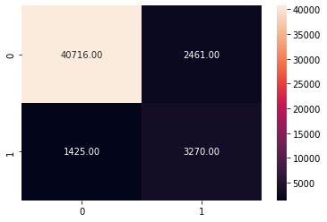

BernoulliNB
RandomForestClassifier
LGBMClassifier
Testing the model performance
Testing the model performance
Testing the model performance
Confusion Matrix
Logistic Regression
DecisionTreeClassifier
Multinomial NB

Slide 16
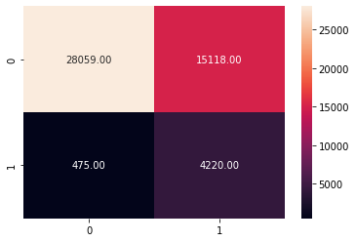
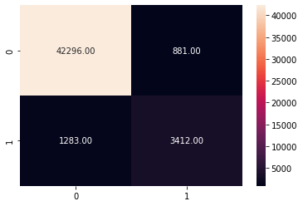

BernoulliNB
RandomForestClassifier
LGBMClassifier
After training and testing the models, the Multinomial NB (mnb), RandomForest Classifier (rfc) and the LGBM Classifier(lgb) are performing well and providing the maximum accuracy score. Now let us check the cross-validation score to find the best performing model.

Slide 17
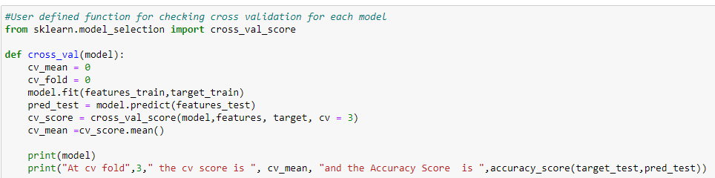
Cross Validation
Code Snippet for Cross Validation
LogisticRegression
At cv fold 3 the cv score is 0.961860239683861 and the Accuracy Score is 0.9181567513368984
DecisionTree Classifier
At cv fold 3 the cv score is 0.9463123000068568 and the Accuracy Score is 0.9201620989304813
MultinomialNB
At cv fold 3 the cv score is 0.9609954241872941 and the Accuracy Score is 0.9537098930481284
BernoulliNB
At cv fold 3 the cv score is 0.7552750404097978 and the Accuracy Score is 0.6751128008021391
RandomForestClassifier
At cv fold 3 the cv score is 0.9621422438099153 and the Accuracy Score is 0.9551094585561497
LGBMClassifier
At cv fold 3 the cv score is 0.9630195989994622 and the Accuracy Score is 0.9513285427807486

Slide 18
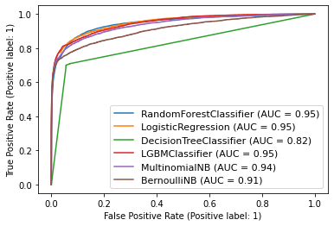
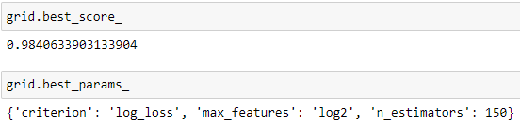
Interpretation of the Results
AUC ROC Curve
The models ['rfc','lr','lgb'] are performing well and providing the maximum ROC AUC Score. Since the RandomForest Classifier model is performing slightly better than all other models, we can consider the rfc model as the best performing model.
AUC ROC Curve
Hyperparameter Tuning
After the hyper parameter tuning the model is performing slightly better.
Best Score and Parameters

Slide 19
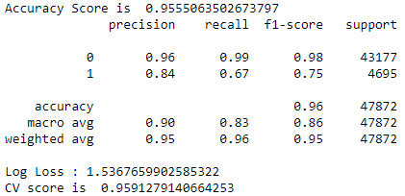


Finalized Model Performance with Tuned Parameters
Final Model Performance
Confusion Matrix
Saving the best model
We have saved the machine learning model for future predictions. We have serialized and saved the binary file as “malignant_comment_classifier.pkl” using the pickle library.

Slide 20
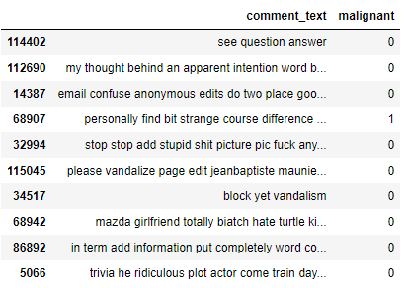
Predicting the target for test data
We have saved the new dataset as ‘Prediction on Test Dataset of Malignant Comments.csv’.
Predicted results for test dataset

Slide 21
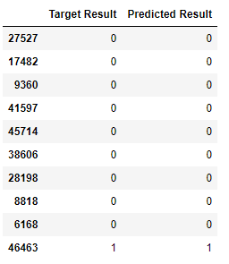
CONCLUSION
Now we have trained our model and it is ready to test with the test data and actual data to cross verify the performance.
Our model is performing well with predictions and provided accurate results.
Testing the model with prediction
The RandomForest Classifier (rfc) model is providing an accuracy score of 95.55% with a cross validation mean score of 95.91%.

Slide 22
Key Findings and Conclusions of the Study
With the help of data science and machine learning, we were able to create a machine learning model using RandomForest algorithm, which can predict whether a user comment is malignant or not.
Now this model can be used to analyse whether the comment is malignant or not.
Learning Outcomes of the Study in respect of Data Science
Due to the possibility of abuse or harassment, conversational toxicity is a problem that can make people stop speaking truthfully and stop asking for other people's thoughts. This project aims to utilise deep learning to identify toxicity in text, which might be used to help prevent users from submitting potentially harmful remarks, build more polite arguments when engaging in dialogue with others, and assess the toxicity of other users' comments. This was done using the help of data science, machine learning and NLP.
To be able to differentiate and distinguish harassing comments and cyberbullying, which we term toxic comments, from regular remarks, it is vital for data scientists to study and understand this type of online harassment. For users who could receive alerts and filter inappropriate content, as well as for moderators of public platforms, automatic recognition of hazardous contents in online forums and social media is a helpful feature. The current work was prompted by the need for more sophisticated procedures and approaches to enhance detection of various forms of online comments.

Slide 23
Limitations of this work and Scope for Future Work
Limitations
The data was vast and included many comments from users along with their nature as features, but it is still lacking many of the important features that could have been impacted detecting whether a comment is malignant or not.
Even though we have identified the problem and proposed a powerful machine learning model, the technology is yet to integrate algorithms like these to the social media platforms as we don’t have an on-time filtering system, which can detect the occurrence of abusive or hatred comments.
We tried all the possible words and combination of words in analysing and detecting malignant comments. But still there are many other types of comments are left out which can potentially be considered as offensive such as comments which are malignant but conveyed in an indirect way, such as dark humour.
Even with this powerful system, we can only detect and prevent the user from writing a malignant comment, but there are other platforms which are not yet advanced to implement systems like these. So, we can only limit the prevention of malignant comments arising on the social media platforms. We are not yet close to completely removing it from the system.
Scope
With more meaningful data and impactful features, in future we will be able to build much more powerful machine learning model which can detect the nature of a comment made by user with more precision and accuracy.
As the technology is advancing, we may be able to find ways to prevent the users from using malignant comments at the time when a user tries to write it instead of reporting or banning the comment once after it was posted.
We should also work on making the users aware of the impact of using malignant comments on social media platforms and how it is impacting the people who are reading the comments. We should be able to remove the thought of a user to write malignant comments by making them aware of the consequences.

Slide 24
Thank You

